Slide 1


Background
Adaptive Markets:
The Evolution of Computations in Markets
Kevin A. McCabe
Professor of Economics, Law, and Neuroscience
George Mason University
kmccabe@gmu.edu

Slide 2
Market
A market is a group of participants who meet for the purpose of exchange. Participants can be humans or artificial intellects and are often given roles like buyer or seller.
Meeting places can be physical (like a grocery store) or digital (like amazon). Digital meeting spaces provide virtual centralization and physical decentralization.
The exchange that takes place can be almost anything including goods, services, and money. See for example,
https://marginalrevolution.com/?s=markets+in .

Slide 3
The Exchange Transaction
Observable Narrative
Person A gives person B the item G at time t.
Person B gives person A the item H at time t+1.
Theory Narrative (aspects may be observable)
Persons A and B meet.
They agree to a trade (G for H, may be implicit)
A gives G at t (believing B will reciprocate).
B gives H at t+1 (completing the agreement )
If exchange is voluntary, and nothing changes between t and t+1, then A and B are both better off. (motivation got trade)
G
t
A
People
B
H
The Exchange Transaction
t+1

Slide 4
The Reciprocal Exchange Transaction
G
Theory Narrative (aspects may be observable)
B looks for A to acquire G.
They agree to a trade (G for H, may be implicit)
At time t,
A gives G to B.
B gives a promise to A.
At time t + 1,
B gives H to A.
A gives goodwill to B fulfilling promise.
The accrual of goodwill with someone makes us more likely to trust them in the future.
t
promise
or debt
A
B
goodwill
H
t+1

Slide 5
Douglass North: Two Kinds of Exchange
Personal
Localized trade
Who you know
Reciprocal exchange
Governance by social norms
Exclusive groups
Less gains from trade
Impersonal
Long distance trade
What you know
Contractual exchange
Governance by rule of law
Inclusive groups
Greater gains from trade
Incentive for evolution
of markets

Slide 6
How Does the Transition Occur
Mediated Exchange
Who Knows You
Subjective
Reputation
(goodwill)
Objective
Reputation
(reporting)
Personal
Localized Trade
Who you know
Reciprocal Exchange
Governance by Norms
Exclusive Groups
Impersonal
Long Distance Trade
What you know
Contractual Exchange
Governance by Rule of Law
Inclusive Groups

Slide 7
An Observable Evolution of Exchange
G
G
t
t
A
People
B
A
People
B
H
M_{t}
The Exchange Transaction
The Exchange Transaction
t+1
Barter Exchange
Monetary Exchange

Slide 8
Money Reduces the Cost of Making an Exchange
Example of Transaction Costs Theory (Ronald Coase)
A unit of account allows prices that reduces search costs by allowing comparison of market value.
A medium of exchange reduces negotiation costs by allowing one side to pay in money and often reduces negotiation to bargaining over price.
A store of value makes it easier to pay on credit.
Monetary transfers also make dispute resolution easier. Pay your debt in cash.
G
G
t
t
promise
M_{t}
A
B
A
B
goodwill
M_{t+1}
H
H
t+1
t+1
Reciprocal Exchange
Monetary Exchange

Slide 9
Fundamental Exchange Computations
V = Buyer’s reservation price (private information)
S_{B} = Buyer’s surplus = V - P
Surplus
P = price
C = Seller’s cost of selling (private information)
S_{S} = Seller’s surplus = P - C

Slide 10
Computation
A computation is a finite sequence of operations that change the state of a system. Usually, we think of state as a data structures which contains measurable values.
An algorithm is a model of the control mechanism (often code) which decides what finite sequence of conditional operations will take place.

Slide 11
What is a computational system?
A computational system consists of:
All possible states and an initial state s⁰.
The set of all possible events. Includes the null event.
A sensory system for recognizing events.
A finite set of operations.
A finite set of event driven algorithms.
By this definition humans, robots, and thermostats are all computational systems.

Slide 12
How does a computational system work?
Every time an event occurs an algorithm is chosen that performs operations to move the state from s^{t} to s^{t+1} and possibly generates new events.
We can think of technology as the available set of operations we can perform, and we can think of our imperative knowledge as the set of algorithms we can perform. This knowledge may be implicit, e.g., driving a car.

Slide 13
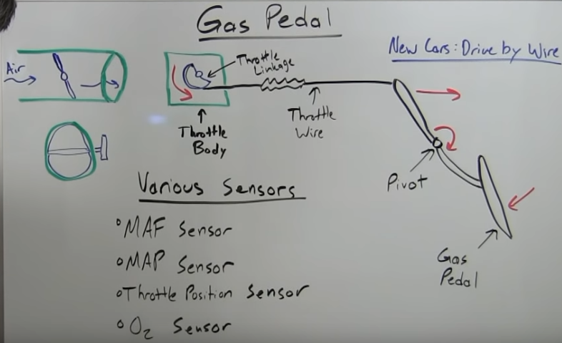
How implicit imperative knowledge works?
m
m
Base
Algorithm
Lower
Level
Algorithm
Message Event
High Level
Algorithm
Message Event
m
m
Base
Algorithm
Message Event
Message Event
Lower
Level
Algorithm
See: https://www.youtube.com/watch?v=smI2ijg4KcM

Slide 14
Market Computation
A market computation is a finite sequence of exchange operations that may result in an exchange transaction. One of the important results of the exchange transaction is price. We can measure transaction costs as the cost of the computation.
The market algorithm is a set of event/message driven decentralized algorithms run by participants and institutions.

Slide 15
Microeconomic Systems Framework
Performance
Environment
Resources
Technologies
Participants
a. Incentives
b. Property
c. Knowledge
d. Skills
e. Beliefs
Outcomes: What
happens as a result of
participants messages and natural forces.
Institution: Rules of Interaction
Accepts Computes
Message Space: How participants communicate
their decisions and what feedback
they get.
Behavior
Hurwicz, Leonid. "Optimality and informational efficiency in resource allocation processes", in Mathematical models in the social sciences, 1959.
Smith, Vernon L. “Microeconomic Systems as an Experimental Science.” The American Economic Review 72, no. 5 (1982): 923–55.
Mount, Kenneth R., and Stanley Reiter. Computation and Complexity in Economic Behavior and Organization. Cambridge University Press, 2002.

Slide 16
Exchange Outcomes
G
t
Produce These
A
People
B
By Doing This
M_{t}
The Exchange Transaction
T
Walk Away
Matching
Negotiation
Fulfillment
Resolution
The Four Essential
Institutions
Continue Relationship ?

Slide 17
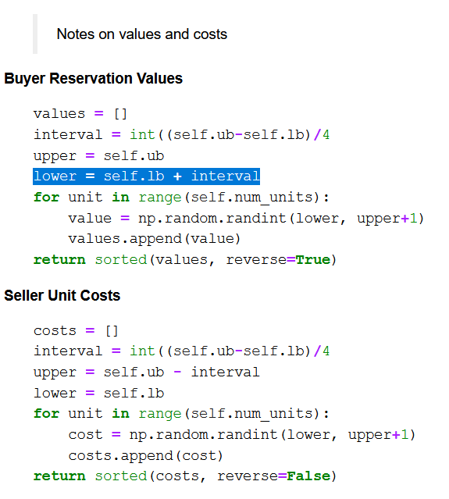

Slide 18
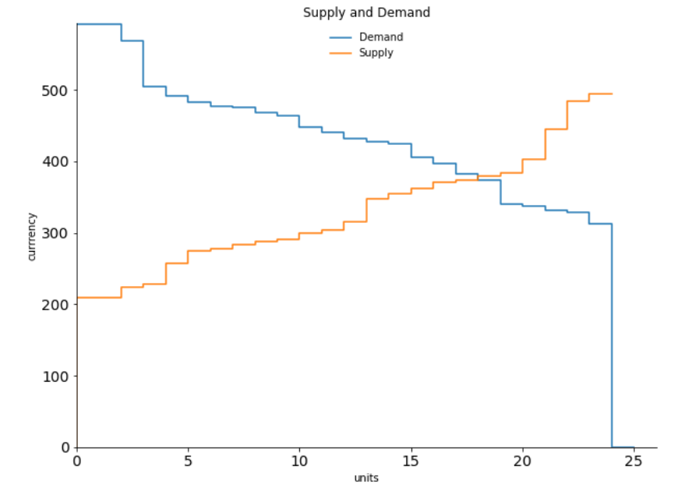

grid_size = 1
num_traders = 8
num_units = 6
lower_bound = 200
upper_bound = 600

Slide 19
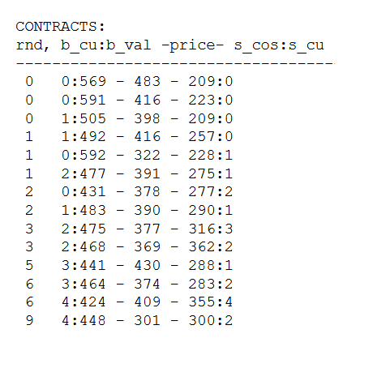
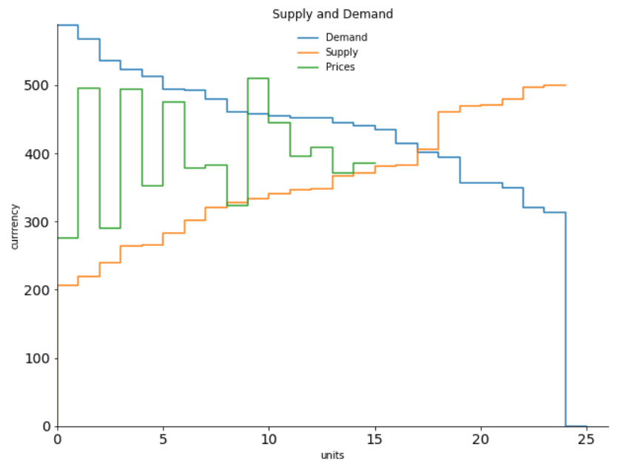
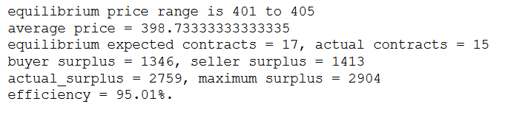

Slide 20
The Exchange Process
Institutions act on the environment to produce outcomes
Connections
Promises
&
Contracts
The Environment
Production
&
Property Transfers
Goodwill &
Side Payments &
Judgments
Resources
- What
Technologies
- How
People
- Who
Matching
Negotiation
Fulfillment
Resolution
Continue Relationship ?

Slide 21
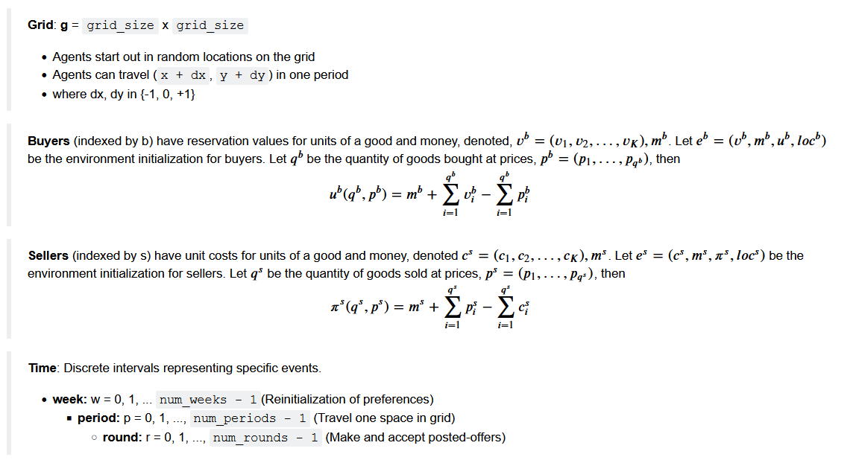

Slide 22
grid_size = 1
num_traders = 8
num_units = 6
lower_bound = 200
upper_bound = 600

Slide 26
Computational Models of Institutions
STATE of WORLD (s)
Ownership Rights: Who own what.
Property Rights: What can people do with what they own.
Preferences: How people value what they own.
Participants: We assume the benefits from rights are personal and how these benefits are managed are `best` for that participant.

Slide 27
Functional Models of Institutions
STATE of WORLD (s)
s^{t}
s^{t+1} = f(s^{t}, m^{t})
Participants:
Believe different states will produce different
expected benefits and join institutions to try to change state.
Institutions:
Accept valid messages from participants and produce state changes based on these messages.
Message Space
Messages
m^{t}

Slide 28
Computational Models of Institutions
STATE of WORLD (s)
Institution
Message Space
Message
Rules
Algorithm
Technology
Participant k
U_{k}(s)
Choose m in M
To send to I
STATE
Process
Discard

Slide 29
Decomposition of Governance Rules
STATE of WORLD (s)
Institution
Message Space
Message Rules
Technology
Algorithm
STATE
Process
Validity
Order
Discard

Slide 30
Transaction Costs are Found in the Process
Matching
Negotiation
Fulfillment
Resolution
Costs of Ensuring
Contract Will Be Executed
Search Costs for
Finding Exchange
Partner.
Transaction
Costs
Negotiation Costs for Finding a Mutual Contract
Costs of Resolving
Disputes

Slide 31
Organizations Own/Manage Institutions
Organization
Decision
Makers
State of Organization (z)
Rights: Who has what roles.
STATE
STATE
STATE
Entrance
Institutions
Governance
Institutions
Production
Institutions
STATE of WORLD (s)

Slide 32
Search for value
Strategy for Market Exchange – Find something
of relatively low value to the people who own it and sell it to people who value it more highly, or more concisely “Buy low, sell high”.
Produce the item at a lower cost than what people are willing to pay for the item.
Find the surplus and reallocate it.

Slide 33
Market Centralization
Buyers are assigned values, e.g.,
B1 has values of $9, $6, $3. Diminishing marginal value.
Buyers receive payoffs of
value – price
starting with their highest value
and working down.
Sellers are assigned costs, e.g., S1 has costs $1, $4, $7. Increasing costs.
Sellers receive payoffs of
price – cost
starting with their lowest cost
and working up.
$
Supply
B1
9
B2
S3
8
B3
S2
7
B1
S1
6
B2
S3
5
S2
B3
4
S1
B1
3
S3
B2
2
S2
B3
Demand
1
S1
0
0
1
2
3
4
5
6
7
8
9
10
Units of Good

Slide 34
Market Theory
$
Supply
B1
9
B2
S3
8
B3
S2
7
B1
S1
6
EQ price
B2
S3
5
S2
B3
4
S1
B1
3
S3
B2
2
S2
EQ Q
B3
Demand
1
S1
0
0
1
2
3
4
5
6
7
8
9
10
Units of Good

Slide 35
Surplus From Trade
$
Supply
B1
9
B2
S3
8
B3
S2
7
B1
S1
6
EQ price
B2
S3
5
S2
B3
4
S1
B1
3
S3
B2
2
S2
EQ Q
B3
Demand
1
S1
0
0
1
2
3
4
5
6
7
8
9
10
Units of Good

Slide 36
Double Auction Institution
Buyers can submit Bid or Buy Orders
Sellers can submit Ask or Sell Orders
Standing Bid: Highest Bid
Standing Ask: Lowest Ask
Buy order causes a contract between the buyer and the seller with the standing ask. price = Standing Ask
Sell order causes a contract between the seller and the buyer with the standing bid. price = Standing Bid
More rules allow for complexity.
ID BID ASK ID
B1 $3
$7 S3
$6 S1
B1 $4
Sell S1

Slide 37
Markets as Microeconomic Systems
Actual Surplus
Price
Supply
Maximum Surplus
Performance
Demand
1
2
3
4
5
Environment:
(values/costs)
Outcomes (contracts)
Institution: DA
Messages
ID BID ASK ID
B1 $3
$7 S3
$6 S1
B1 $4
Sell S1

Slide 38
A Decentralized Computational Approach
Information:
Standing Bid: ### ID: ###
Standing Ask: ### ID: ###
Contracts
Institution
Participants:
If Buyer:
Given values and information
choose messages to maximize
the buyer’s surplus.
If Seller:
Given costs and information
choose messages to maximize
the seller’s surplus.
Start DA from Organization Rule
If Bid > Standing Bid:
Update Standing Bid
If Ask < Standing Ask:
Update Standing Ask
If Buy:
Contract at p = Standing Ask
If Sell:
Contract at p = Standing Bid
End DA from Organizational Rule
Messages:
If Buyer:
Bid: ### ID: ###
Buy: ID: ###
If Seller:
Ask: ### ID: ###
Sell: ID: ###

Slide 39
Experiments on Markets using Human Subjects
Actual Surplus
Price
Supply
Maximum Surplus
Performance
Demand
1
2
3
4
5
Environment:
(values/costs)
Outcomes (contracts)
Institution: DA
Messages
ID BID ASK ID
B1 $3
$7 S3
$6 S1
B1 $4
Experimenter Controls
Sell S1

Slide 40
Experiments on Markets using Human Subjects
Actual Surplus
Price
Supply
Maximum Surplus
Performance
Demand
1
2
3
4
5
Environment:
(values/costs)
Outcomes (contracts)
Institution: DA
Messages
ID BID ASK ID
B1 $3
$7 S3
$6 S1
B1 $4
Experimenter Controls
Experimenter Observes
Sell S1

Slide 41
An Experimental Approach
Information:
Standing Bid: ### ID: ###
Standing Ask: ### ID: ###
Contracts
Institution
Human Subjects:
If Buyer:
Given values and information
choose messages to maximize
the buyer’s surplus (payment).
If Seller:
Given costs and information
choose messages to maximize
the seller’s surplus (payment).
Start DA from Organization Rule
If Bid > Standing Bid:
Update Standing Bid
If Ask < Standing Ask:
Update Standing Ask
If Buy:
Contract at p = Standing Ask
If Sell:
Contract at p = Standing Bid
End DA from Organizational Rule
Messages:
If Buyer:
Bid: ### ID: ###
Buy: ID: ###
If Seller:
Ask: ### ID: ###
Sell: ID: ###

Slide 42
Vernon Smith, “An Experimental Study of Competitive Market Behavior,” Journal of Political Economy, 70, (1962), 111-137.

Slide 43
Agent Based Modeling
Gode and Sunder (1993, 1997ab) simulations using agent-based modeling!
• asked whether the rapid convergence of prices and quantities to competitive equilibrium in laboratory double auction experiments, e.g., Smith (1962) was due to human strategies or to the Double Auction institutions and the enforcement of minimal rationality on agents.
• They replaced the human subjects with zero-intelligence (no memory), unconstrained or budget constrained robot traders and found that the budget constrained robot traders did as well or better than the human subject traders in terms of extracting gains from trade.

Slide 44
A Simulation Approach
Institution
Participants: ZI Traders
If Buyer:
If you have bought n-1 units
and have a reservation price
V_{n} > 0 then:
UC: bid ~ U[min_bid, max_bid]
BC: bid ~ U[min_bid, V_{n}]
if bid ≥ Standing Ask - > Buy
If Seller:
If you have sold n-1 units
and have a unit cost
C_{n} > 0 then:
UC: ask ~ U[min_ask, max_ask]
BC: ask ~ U[C_{n} , max_ask]
if ask ≤ Standing Bid - > Sell
Information:
Standing Bid: ### ID: ###
Standing Ask: ### ID: ###
Contracts
Start DA from Organization Rule
If Bid > Standing Bid:
Update Standing Bid
If Ask < Standing Ask:
Update Standing Ask
If Buy:
Contract at p = Standing Ask
If Sell:
Contract at p = Standing Bid
End DA from Organizational Rule
Messages:
If Buyer:
Bid: ### ID: ###
Buy: ID: ###
If Seller:
Ask: ### ID: ###
Sell: ID: ###

Slide 45
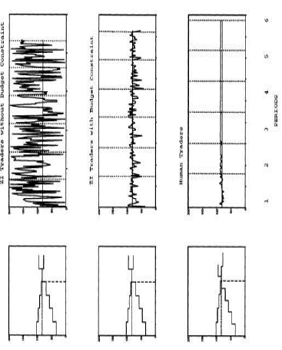
Agent Based Model Results
ZI Trader without Budget Constraint
ZI Trader with Budget Constraint
Human Traders

Slide 46
Thank You

